Slide 1
Random Variable & Probability Distributions

Slide 2
Flow of the presentation
Random Variables
Probability Distributions
Probability Mass/Density Functions
Expected Value
Bernoulli’s trial Experiments
Binomial Distribution
Poisson Distribution
Normal Distribution

Slide 3
Random Variable
Definition: A random variable is a rule that assigns a number to each outcome of an experiment.
e.g. If a coin is tossed twice, random variable X: number of heads that appears
OUTCOME X
HH 2
HT 1
TH 1
TT 0

Slide 4
Types of Random Variable
Discrete: which can take finite or isolated values is the given interval, it can be measured exactly
e.g. The number of heads in tossing coins
2. Continuous: which can take all possible values that are infinite, it cannot be measured exactly
e.g. The number of blank calls during 11.00 a.m. to 1.00 p.m.

Slide 5
Types of Probability Distribution
Discrete Probability Distribution (random variable is discrete)
Binomial Distribution
Poisson Distribution
2. Continuous Probability Distribution (random variable is continuous)
Normal Distribution

Slide 6
Probability Distribution (Discrete)
Definition: If a discrete random variable has the values x1, x2, …,xn then a probability distribution P(x) is a rule that assigns a probability P(xi) to each value xi.
a)
b)

Slide 7
Probability Functions
A real valued function f(x) which gives the probability of occurrence of event ‘x’ is called probability function defined as, P(X=x)=f(x).
x is discrete: P(X=x)=f(x) is called Probability Mass Function
x is continuous: P(x-dx/2 < =X <= x+dx/2)= f(x)dx is called Probability Density Function and y=f(x) is called the Probability Curve.

Slide 8
e.g. An experiment randomly selected two people from group of five men and four women. A random variable X is the number of women selected. Find the probability distribution function of X.
Solution:
P(0)= 5C2/9C2=5/18 (Probability both are men)
P(1)=(5C1*4C1)/9C2=5/9 (Probability of 1 men and 1 women)
P(2)=4C2/9C2= 1/6 (Probability both are women)
X= 0 1 2
P(X)=5/18 5/9 1/6

Slide 9
Expected Value
Definition: IF X is a random variable then the expected value of X, denoted by E(X) is defined as,

Slide 10
e.g. A tray of electronics components contains nine good components and three defective components. If two components are selected at random, what is the expected number of defective components?
Solution:
P(0)= 12/22, P(1) = 9/22, P(2) = 1/22
E(X)= ½
(i.e. if a large number of selections are made, average ½ each time we expect to get no defective a little less then half time and either one or two the rest of the time, but the average will be one half)

Slide 11
Discrete Probability Distribution
Bernoulli Experiment which leads to Binomial Distribution
Poisson Distribution

Slide 12
Bernoulli Trial Experiments
Problems involved repeated trials of an experiment with only two possible outcomes are called Bernoulli trial experiments.
Properties:
The experiment is repeated a fixed number of times (n times)
Each trial has only two possible outcomes: success and failure
The probability of success remains the same for each trial
The trials are independent
We are interested only in the total number of success (in any order)

Slide 13
Probability of a Bernoulli Experiment
Given a Bernoulli experiment and n independent repeated trials,
p: probability of success in single trial
q: probability of failure in single trial
Then the probability of x success in n trial is,

Slide 14
Binomial Distribution
Consider, Bernoulli experiment with probability distribution function
for which the probabilities are the successive terms in the binomial expansion
hence it is called Binomial Distribution.

Slide 15
Mean, Variance and Standard Deviation (Binomial Distribution)
Mean
Variance
Standard Deviation

Slide 16
Examples:
An expert claims that he can distinguish between a cup of instant coffee and a cup of percolator coffee 75% of the time. It is agreed that his claim will be accepted if he correctly identifies at least 5 of the 6 cups. Find his chances of having the claim
(i) accepted (ii) rejected, when he does have the ability he claims.
Solution:
p: the probability of a correct distinction between a cup of instant coffee and a cup of percolator coffee
p = 75/100=3/4, q = ¼
X: random variable defined as number of tomes correct distinctions
(i) P(X>=5)= 0.534, (ii) P(X<=4)=1-P(X>=5)=0.466
Conti…

Slide 17
2.
A multiple choice test consists of 8 questions with 3 answers to each question. A student answers each questions by rolling a balanced die and checking the first answer if he gets 1 or 2, the second answer if he gets 3 or 4 and the third answer if he gets 5 or 6. To get a distinction, the student must secure at least 75% correct answers. If there is no negative marking, what is the probability that the student secures a distinction?
Solution:
p: the probability of getting an answer to a question correctly=1/3
X: random variable, getting x correct answers:
For getting distinction (6 out of 8 must be correct answer),
P(X>=6)= 0.0197

Slide 18
3. An irregular six-faced die is thrown and the probability that in 10 throws it will give five even numbers is twice the probabilitty that it will give four even numbers. How many times in 10,000 sets of 10 throws each, would you expect it to give no even number?
Solution:
p: probability of getting an even number in a throw of a die
X: getting even number in 10 throws of a die
We have P(5)=2P(4),

Slide 19
P(5)=2*P(4)
=>10C5*p^5*(1-p)^5 = 2* 10C4*p^4*(1-p)^6
=>(3/5)p = 1-p
=>(8/5)p=1
=>P=5/8
=>p= 5/8 and q=1-p=3/8
Required number of times that in10,000 sets of 10 throws each, we get no even number =10,000*P(0)=0.55

Slide 20
4. A department in a works has 10 machines which may need adjustment from time to time during the day. Three of these machines are old, each having a probability of 1/11 of needing adjustment during the day and 7 are new having corresponding probabilities of 1/21. Assuming that no machine needs adjustment twice on the same day, determine the probability that on a particular day just 2 old and no new machines need adjustment.
Solution:
p1: an old machine needs adjustment = 1/11=> q1=10/11
p2 : a new machine needs adjustment = 1/21=> q2=20/21
X1: ‘x’ old machine needs adjustment= P1(x)=(3Cx)(p1^x)(q1^(3-x))
X2: ‘x’ new machine needs adjustment= P2(x)=(7Cx)(p2^x)(q2^(7-x))
Required probability, P1(2)*P2(0)=0.016

Slide 21
Poisson Distribution
Poisson Distribution was discovered by French Mathematician Simeon Denis Poisson in 1873. It is limiting case of the binomial distribution under the following conditions:
n, the number of trials is indefinitely large
p, the probability of success for each trial is indefinitely small
n*p = λ (mean)

Slide 22
Definition
A random variable X is said to follow a Poisson distribution if it assumes only non-negative values and its probability mass function is given by:

Slide 23
Examples:
A manufacturer of cotter pins knows that 5% of his products is defective. If the sells cotter pins in boxes of 100 and guarantees that not more than 10 pins will be defective, what is the approximate probability that a box will fail to meet the guaranteed quality ?
Solution:
n: 100, p: probability of a defective pin= 0.05, λ = n*p=5
X: random variable denote the number of defective pins in a box of 100

Slide 24
2. A car hire has two cars, which it hires out day by day. The number of demand for a car on each day is distributed as a Poisson distribution with mean 1.5. Calculate the proportion of days on which (i) neither car is used, and (ii) the proportion of days on which some demand is refused.
Solution:
X: random variable denotes the number of demands for a car on any day
λ: 1.5 (mean)
(i) P(X=0)= 0.2231 (ii) P(X>2)=1-P(X<=2)=0.19126

Slide 25
3. A manufacturer, who produces medicine bottles, find that 0.1% of the bottle are defective. The bottles are packed in boxes containing 500 bottles. A drug manufacturer buys 100 boxes from the producer of bottles. Find how many boxes contain:
(i) no defective and (ii) at least two defective
Solution:
n=500, p: probability of defective bottle = 0.001, λ = n p = 0.5
X: random variable denotes the number of defective bottles in a box
100*P(X=0) = 60.65≈61,
100*P(X>=2)=100*[1-{P(0)+P(1)}]=9.025≈10

Slide 26
Continuous Distribution: Normal Distribution
First discovered in 1753 by Abraham De Moivre
Rediscovered in 18th century by Gauss in theory of error- Gaussian distribution
Derived from Binomial Distribution when n is very large, neither p nor q is very small

Slide 27
Probability Density Function
The general equation of the normal curve or probability density function is

Slide 28
Standard form of the Normal Distribution
Standard normal variable:
=> Mean = 0, standard deviation = 1
Probability density function for the normal distribution in standard form is given by

Slide 29
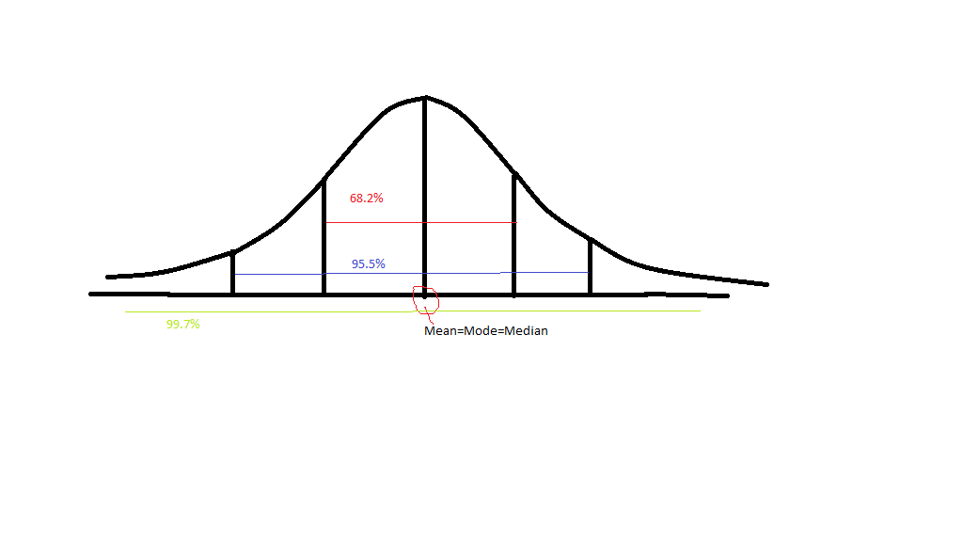
Normal Curve

Slide 30
Properties of PDF
If f(z) is the probability density function for the normal distribution, then
F(-z)=1-F(z)

Slide 31
Probability Calculations Using Normal Variable Table
To find the different probabilities, the standard normal distribution is used.
Standard normal variable:
The values of the probabilities corresponding to Z are tabulated and can be found using “table for area under standard normal curve”
3.

Slide 32
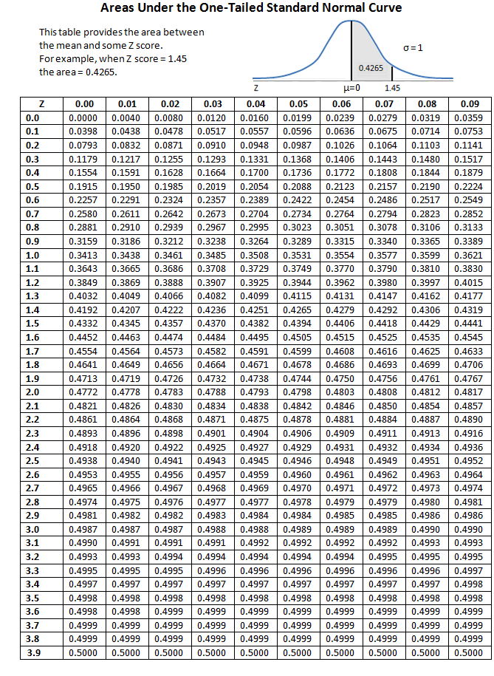

Slide 33
Examples:
In a production process the diameter of items is distributed normally with mean 4.3 and variance 0.09. 200 items are having less than 4 cms. diameter. Estimate the total number of items in the production.
Solution:

Slide 34
2. In a test on 2000 electric bulbs, it was found that the life of a particular make was normally distributed with an average life of 2040 hours and standard deviation of 60 hours. Estimate the number of bulbs likely to burn for (i) more than 2150 hours, (ii) less than 1950 hours and (ii) more than 1920 hours but less than 2160 hours.
Solution:

Slide 37
3. In a government office 5000 employees are working. The distribution of their monthly salary is normal with mean Rs. 7000 and standard deviation Rs. 20. Find (i) the range of monthly salaries of 25% employees, who are getting minimum salary and (ii) the minimum monthly salary of 1% employees, who are getting highest salary.
Solution:

Slide 39
Thank You

